Slide 1
T4. Google Trends data
Dr. Eduardo Cebrián Cerdá

Slide 2
Materials Needed
Code for the tutorial: https://rpubs.com/ecebcer/1190032
PC with R-Studio: https://posit.co/download/rstudio-desktop/
GitHub repository (just in case): https://github.com/ecebcerupv/T4-Google-Trends-data-CARMA-2024-
Theoretical background: https://www.sciencedirect.com/science/article/pii/S0040162524001148

Slide 3
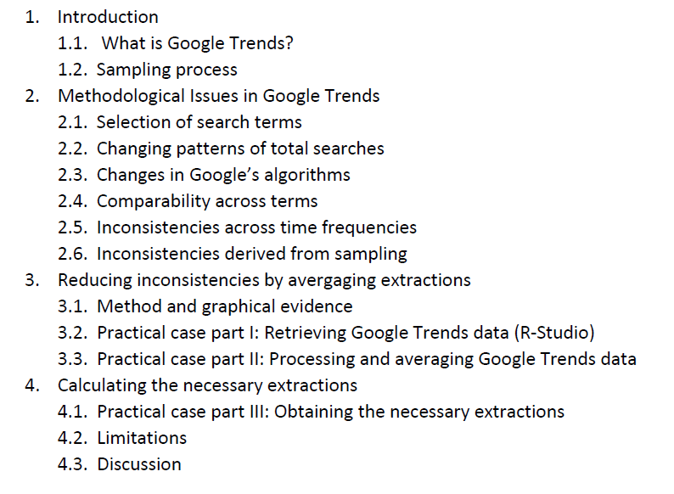
Outline

Slide 4
1. Introduction

Slide 5
What is Google Trends?
Free tool developed by Google which reports the evolution of the popularity of searches made through Google.
Widely used. Medicine (Díaz et al., 2023); politics (Jelnov and Jelnov, 2022); economics (Bantis et al., 2023); tourism (Dergiades et al., 2018)…
The main output are time series data which represent the Search Volume Index (SVI), a relative measure of the popularity of the term.

Slide 6
What is Google Trends?
The popularity of a search term is constructed based on different variables that can be added to the interface of Google Trends:
Geographical area
Time span (determines frequency)
Search method: search terms, categories, entities..

Slide 7
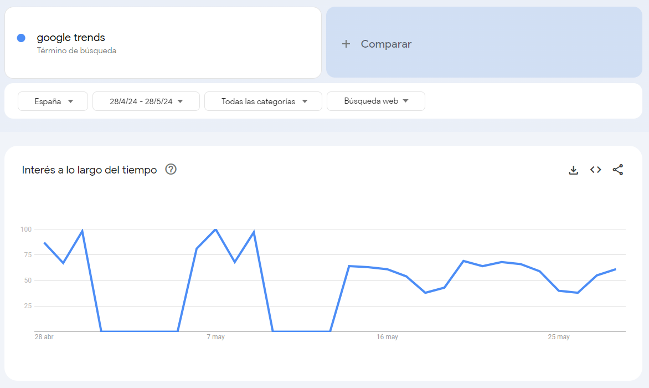
What is Google Trends?
This is how I did this search, back on May 28th…
https://trends.google.es/trends/explore?date=2024-04-28%202024-05-28&geo=ES&q=google%20trends&hl=es
Notice any differences?
Let’s check

Slide 8
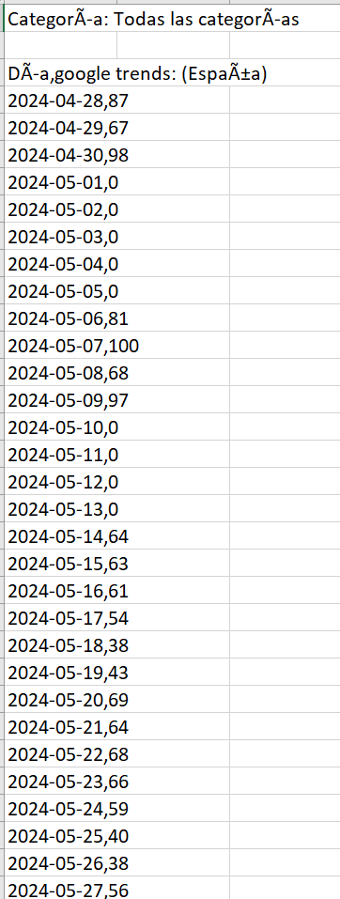
What is Google Trends?
Your points might be really similar to mine… or not..
That’s because of the sampling in Google Trends..

Slide 9
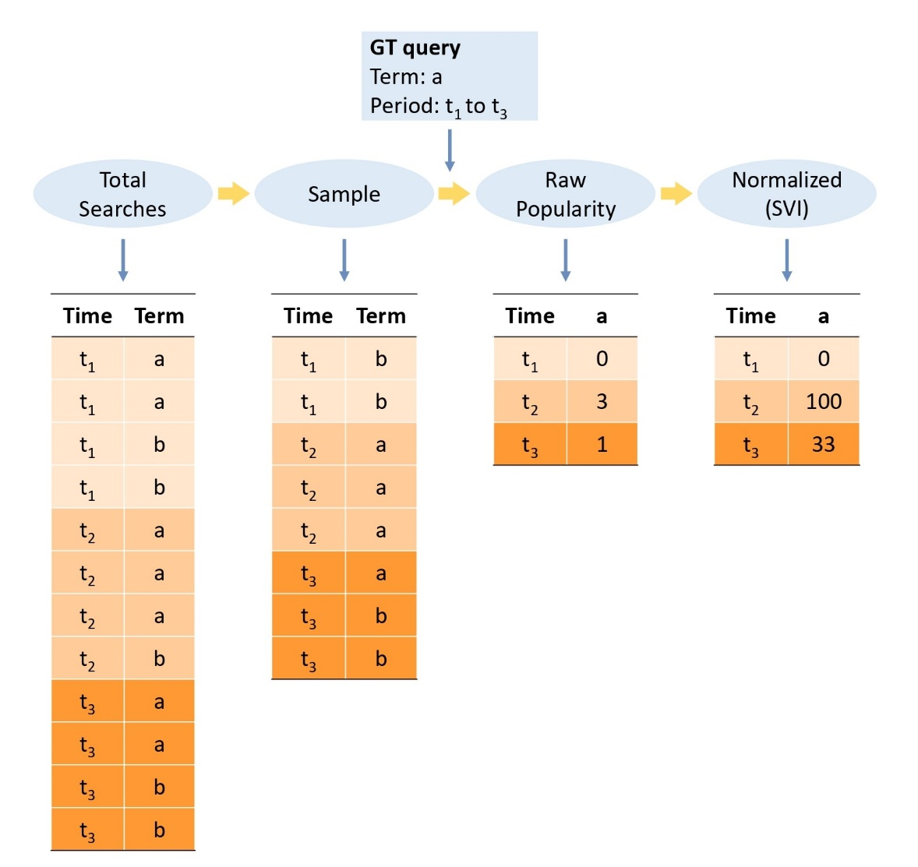
Google Trends sampling
We know this is how it happens, but the parameters are unknown.
This can introduce an error, check that had we used a representative sampling, the SVI for term ‘a’ should have been 67,100,67.

Slide 10
2. Methodological issues in Google Trends

Slide 11
Selection of search terms
Initial step when working with Google Trends. This may already present some difficulties…
GT may reflect irrational behavior, like overreaction to news (Jun et al., 2018).
Media coverage may influence results (Butler et al., 2013).
Semantic interpretation of search terms, as they are language specific (Arora et al., 2019).
Poor documentation in academic research makes reproducing results difficult (Nuti et al., 2014).

Slide 12
Changing patterns of total searches
The SVI reports the volume of specific search terms relative to total searches. Total searches are often changed by Google.
The change of habits in Internet usage affect Total searches (Woloszko, 2020)
Because the internet has expanded so have Google searches, so are they really comparable?
Also, other events such as COVID-19 can disturbe the search patterns (Knipe et al., 2021).

Slide 13
Changes in Google’s algorithms
Algorithmic changes both in GT as well as Google Search engine can introduce abrupt breaks in GT series which need to be accounted for (Bokelmann and Lessmann, 2019).
Because Google provides a suggested list of search terms, it biases behavior of users (Lazer et al., 2014).

Slide 14
Comparability across terms
Comparing SVI’s for different terms also represents a challenge in GT, mainly because each series is normalized to its peak popularity.
Comparability has to be done by quering two terms at once, but this will report 0’s for very low popularities.
This can be solved by chaining terms (Malagón-Selma et al., 2023) or by using benchmark terms (Springer et al., 2023).
Certain search terms might be inflated due to their nature, f.e. financial investment.

Slide 15
Inconsistencies across time frequencies
GT provides data in various time frequencies, but the consistency among them is not guaranteed (Eichenauer et al, 2022).
Wolozsko (2020): Weekly series do not align consistently with monthly series.
Eichenauer (2022): Raw data varies when comparing different time frequencies.

Slide 16
Inconsistencies derived from sampling
Derived from GT reporting data based on a sample of queries which change daily.
Identical queries might not return the same set of results (Cebrián and Domenech, 2023).
Most authors do not explicitely treat these inconsistencies.
Some others do identify them, but consider them to be negligible (Da et al. 2011).
This will be our focus!

Slide 17
3. Reducing incosistencies by averaging extractions

Slide 18
Method and graphical evidence
One common method that several authors have used to overcome these inconsistencies has been to perform different extractions and then use the average SVI.
D’Amuri and Marcucci (2017) take 24 extractions for the search term ‘Jobs’.
Saxa (2015) take 10 extracctins for mortgage-related terms.
But does this work?

Slide 19
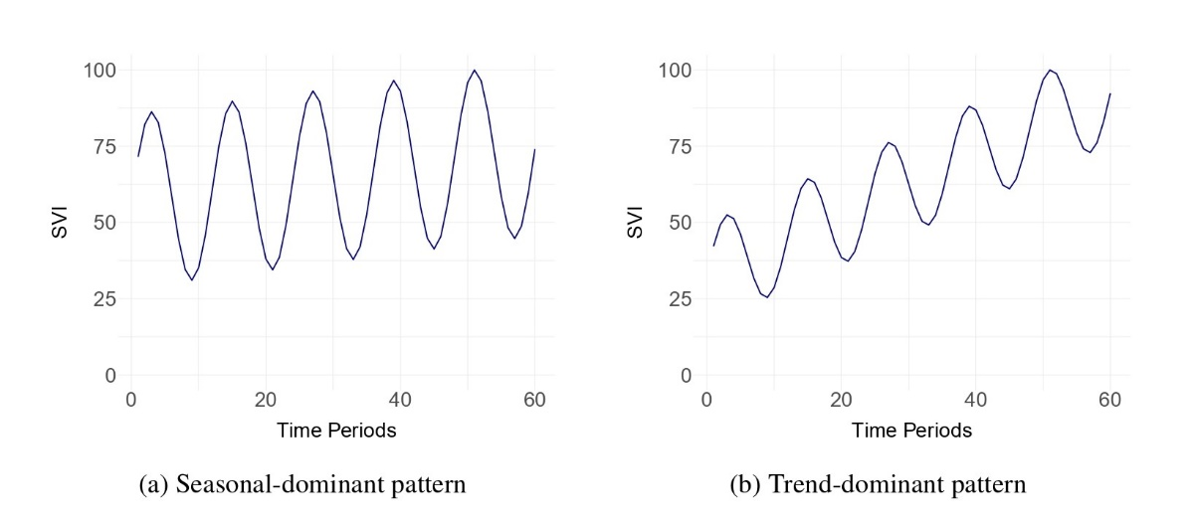
Method and graphical evidence

Slide 20
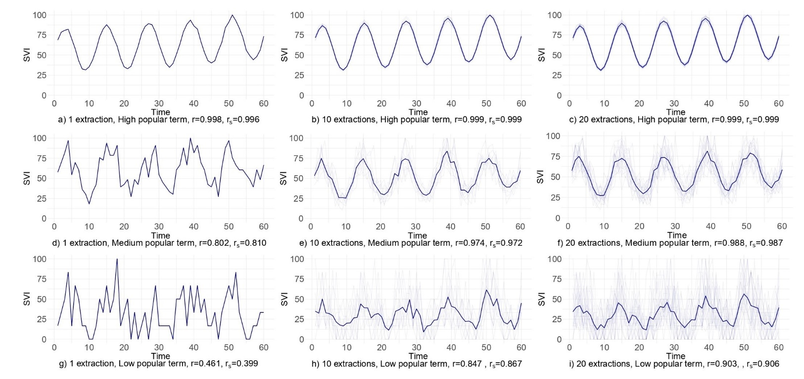
Method and graphical evidence

Slide 21
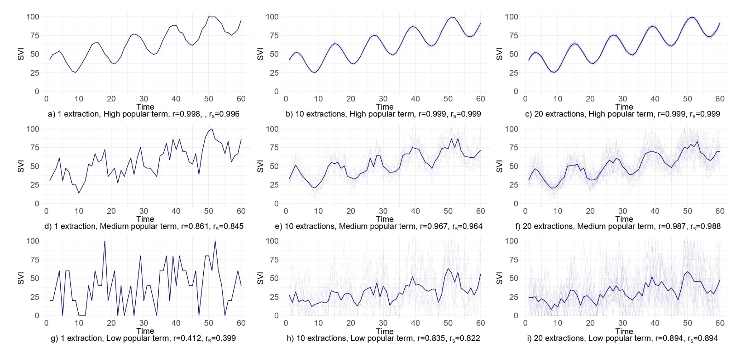
Method and graphical evidence

Slide 22
Method and graphical evidence
We observe that the more popular the query, the less extractions vary amongst each other. Therefore, we consider the standard deviation between different extractions to be an indirect measure of the popularity of the query.

Slide 23
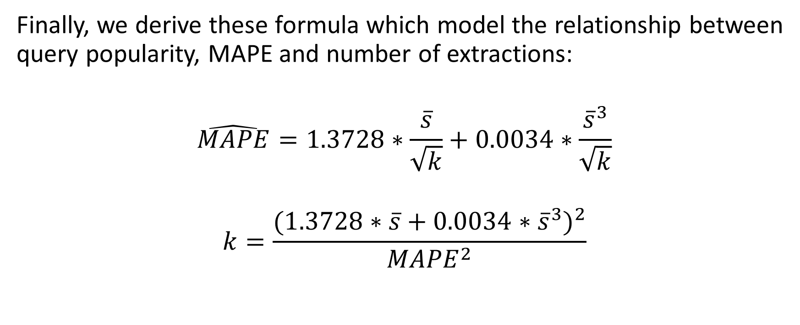
Method and graphical evidence
Finally, we derive these formula which model the relationship between query popularity, MAPE and number of extractions:
$$\hat{MAPE}=1.3728∗\frac{\overline{s}}{\sqrt{k}}+0.0034∗\frac{{\overline{s}}^{3}}{\sqrt{k}}$$
$$k=\frac{{(1.3728∗\overline{s}+0.0034∗{\overline{s}}^{3})}^{2}}{{MAPE}^{2}}$$

Slide 24
Practical Case part I: Retrieval
In order to retrieve the data, we can use a trick implemented by Askitas (2011) and the R-package ‘trendecon’, by Eichenauer (2022).
We create a vector of letters which can be used to perform different samples of the same query.
Note: You could also do this with the R-package ‘gtrendsR’.

Slide 25
Practical Case part I: Retrieval
Steps:
Create the vector of letters (Askitas, 2015).
Retrieve the queries using the ‘trendecon’ package (Eichenauer, 2022).
Check the difference among extractions (Cebrián and Domenech, 2023).

Slide 26
Practical Case Part II: Processing
Remember that the way in which we compute the popularity of a query its through its standard deviation across extractions.
To do that, we first calculate the standard deviation for each data point in the series
And then compute the average of s.d.’s across all points in the series.

Slide 27
Practical Case Part II: Processing
Then, using the formulas we can obtain:
The minimum amount of error obtainable given the standard deviation of a query
And the amount of necessary extractions in order to create an SVI with the desired amount of error.

Slide 28
4. Calculating the necessary extractions

Slide 29
Practical Case Part III: Solving
In our case, 46 more extractions are needed on top of the ones which we obtained at the beginning.
To do that, once again we obtain the extractions (Practical Case Part I).
And finally, create a rescaled SVI which will be consistent to the desired amount of error.
This latest SVI is the one which can be used for forecasting, nowcasting, etc in a consistent manner.

Slide 30
Discussion / Limitations
https://www.canva.com/design/DAGIHr0GPi0/eixKqzyR0QeHkvmrisFHrA/edit?utm_content=DAGIHr0GPi0&utm_campaign=designshare&utm_medium=link2&utm_source=sharebutton It’s your turn now!

Slide 31
Thank you for your attention!

Slide 32
References

Slide 33
Arora, V. S., McKee, M., and Stuckler, D. (2019). Google Trends: Opportunities and limitations in health and health policy research. Health Policy, 123(3), 338–341. https://doi.org/10.1016/j.healthpol.2019.01.001.
Askitas, N. (2015). Google search activity data and breaking trends. IZA World of Labor, 206. https://doi.org/10.15185/izawol.206.
Bantis, E., Clements, M. P., and Urquhart, A. (2023). Forecasting GDP growth rates in the United States and Brazil using Google Trends. International Journal of Forecasting. https://doi.org/10.1016/j.ijforecast.2022.10.003.
Bokelmann, B. and Lessmann, S. (2019). Spurious patterns in Google Trends data – An analysis of the effects on tourism demand forecasting in Germany. Tourism Management, 75, 1–12. https://doi.org/10.1016/j.tourman.2019.04.015.

Slide 34
Butler, D. (2013). When Google got flu wrong. Nature, 494, 155-156. https://doi.org/10.1038/494155a.
Cebrián, E. and Domenech, J. (2023). Is Google Trends a quality data source? Applied Economics Letters, 30(6), 811-815. https://doi.org/10.1080/13504851.2021.2023088.
Cebrián, E. and Domenech, J. (2024). Addressing Google Trends inconsistencies. Technological Forecasting and Social Change, 202, 123318. https://doi.org/10.1016/j.techfore.2024.123318.
Da, Z., Engelberg, J., and Gao, P. (2011). In search of attention. Journal of Finance, 66, 1461-1499. https://doi.org/10.1111/j.1540-6261.2011.01679.x.

Slide 35
D’Amuri F. and Marcucci, J. (2017). The predictive power of Google searches in forecasting US unemployment. International Journal of Forecasting, 33(4), 801-816. https://doi.org/10.1016/j.ijforecast.2017.03.004.
Dergiades, T., Mavragani, E., and Pan, B. (2018). Google Trends and tourists’ arrivals: Emerging biases and proposed corrections. Tourism Management, 66, 108-120. https://doi.org/10.1016/j.tourman.2017.10.014.
Díaz, F., Henríquez, P., Hardy, N., and Ponce, D. (2023). Population well-being and the COVID-19 vaccination problem in Chile: evidence from Google Trends. Public Health. 219, 22-30. https://doi.org/10.1016/j.puhe.2023.03.007.
Eichenauer, V. Z., Indergand, R., Martínez, I. Z., and Sax, C. (2022). Obtaining consistent time series from Google Trends. Economic Inquiry, 60(2), 694-705. https://doi.org/10.1111/ecin.13049.

Slide 36
Jelnov, A. and Jelnov, P. (2022). Vaccination policy and trust. Economic Modelling, 108, 105773. https://doi.org/10.1016/j.econmod.2022.105773.
Jun, S.-P., Yoo, H. S., and Choi, S. Ten years of research change using Google Trends: From the perspective of Big Data utilizations and applications. Technological Forecasting and Social Change, 130, 69-87. https://doi.org/10.1016/j.techfore.2017.11.009.
Knipe, D., Gunnell, D., Evans, H., John, A., and Fancourt, D. (2021). Is Google Trends a useful tool for tracking mental and social distress during a public health emergency? A time-series analysis. Journal of Affective Disorders, 294, 737-744. https://doi.org/10.1016/j.jad.2021.06.086.
Lazer, D., Kennedy, R., King, G., and Vespignani, A. (2014). The parable of Google Flu: Traps in Big Data Analysis. Science, 343(6176), 1203-1205. https://doi.org/10.1126/science.1248506.

Slide 37
Malagón-Selma, P., Debón, A., and Domenech, J. (2023). Measuring the popularity of football players with Google Trends. PLOS ONE, 18(8), 1-21. https://doi.org/10.1371/journal.pone.0289213.
Nuti, S. V., Wayda, B., Ranasinghe, I., Wang, S., Dreyer, R. P., Chen, S.I., and Murugiah, K. (2014). The use of Google Trends in health care research: A systematic review. Journal of Elections, Public Opinion and Parties, 9, 1-49. https://doi.org/10.1371/journal.pone.0109583.
Saxa, B. (2015). Forecasting mortgages: internet search data as a proxy for mortgage credit demand. National Bank of the Republic of Macedonia, 107. https://www.nbrm.mk/WBStorage/Files/WebBuilder_Working_Paper_4th_Research_Conference.pdf#page=10 [Online;accessed: 14-06-2024]
Springer, S., Strzelecki, A., and Ziegler, M. (2023). Maximum generable interest: A universal standard for Google Trends search queries. Healthcare Analytics, 3, 100158. https://doi.org/10.1016/j.health.2023.100158.

Slide 38
Woloszko, N. (2020), "Tracking activity in real time with Google Trends", OECD Economics Department Working Papers, No. 1634, OECD Publishing, Paris, https://doi.org/10.1787/6b9c7518-en.

